Slide 1




CUSTOMER
PRESENTATI ON - 2024
D A T A M A N A G E M E N T AN D A N A L Y S I S
..............

Slide 2
Team Members
Karima Ibrahim Mohamed
Ahmed Ahmed Khamis
Ahmed Serry Abdul Hameed Hassan
Abdelrhman Yassein Mohalill
Maryam Sayed AbdElRahman Ghanem Yasmine Rafaat
Nermine Micheil Mikhail
Gamil Samir Mounir
Abdelrahman Saleh Mahmoud

Slide 3




Agenda
Week 1:
Data Management and SQL Database Setup You’ll focus on designing the database, managing customer information, and interactions. This ensures that your data foundation is solid for future analysis.
Deliverables include a populated SQL database and basic SQL queries for extracting and analyzing customer data.
Week 3:
Data Science and Azure
Integration
In this week, you’ll dive into data science by performing Predictive model and integrating Azure services for efficient data management.
Deliverables: Predictive models and a setup for Azure Data services.
Week 4:
Deploy the machine learning model using Azure services by Automated ML for model predictions.
Week 2:
Data Warehousing and Python Programming
You’ll implement a SQL Data Warehouse to handle large- scale customer data for analytical purposes, then use Python for data extraction and preparation.
Deliverables: A functioning data
warehouse and Python scripts..

Slide 4
Problem Statement
Business Challenge: Our organization manages vast amounts of customer data across multiple platforms, but lacks a unified, efficient system to integrate, analyze, and leverage this information for decision-making.
Key Issues:
Data Fragmentation: Customer data is dispersed across various departments and databases, leading to inconsistencies and incomplete records.
Inadequate Churn Prediction: Without advanced predictive capabilities, it’s challenging to identify at-risk customers and proactively address their concerns, resulting in higher churn rates.
Inefficient Data Analysis: Limited tools and processes for comprehensive customer data analysis reduce our ability to predict trends or identify customer needs accurately.
Scalability Concerns: As data volume grows, existing systems struggle to maintain performance and accessibility, impeding real-time insights.
Project Motivation: To address these challenges, we initiated a project to develop a centralized data management and analysis system. This will not only streamline customer data handling and enhance predictive capabilities for churn reduction but also enable data-driven decision-making, improve customer relationship management, and position us to scale with future growth.

Slide 5
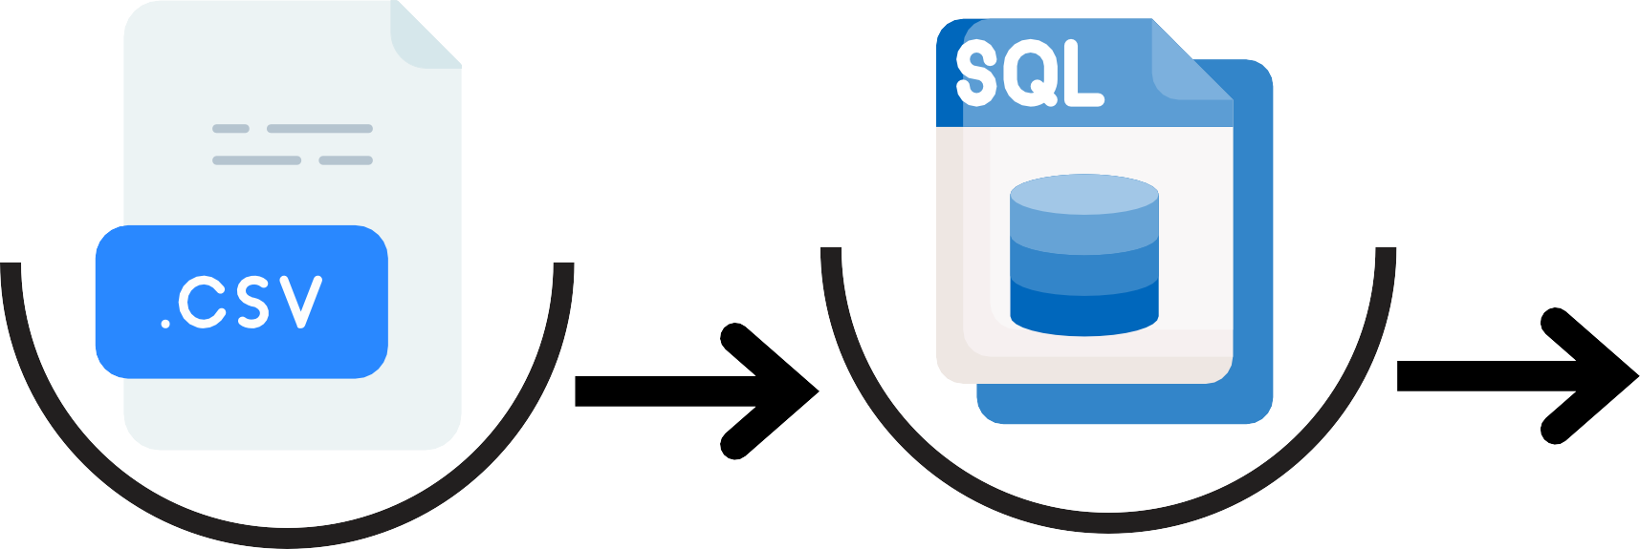

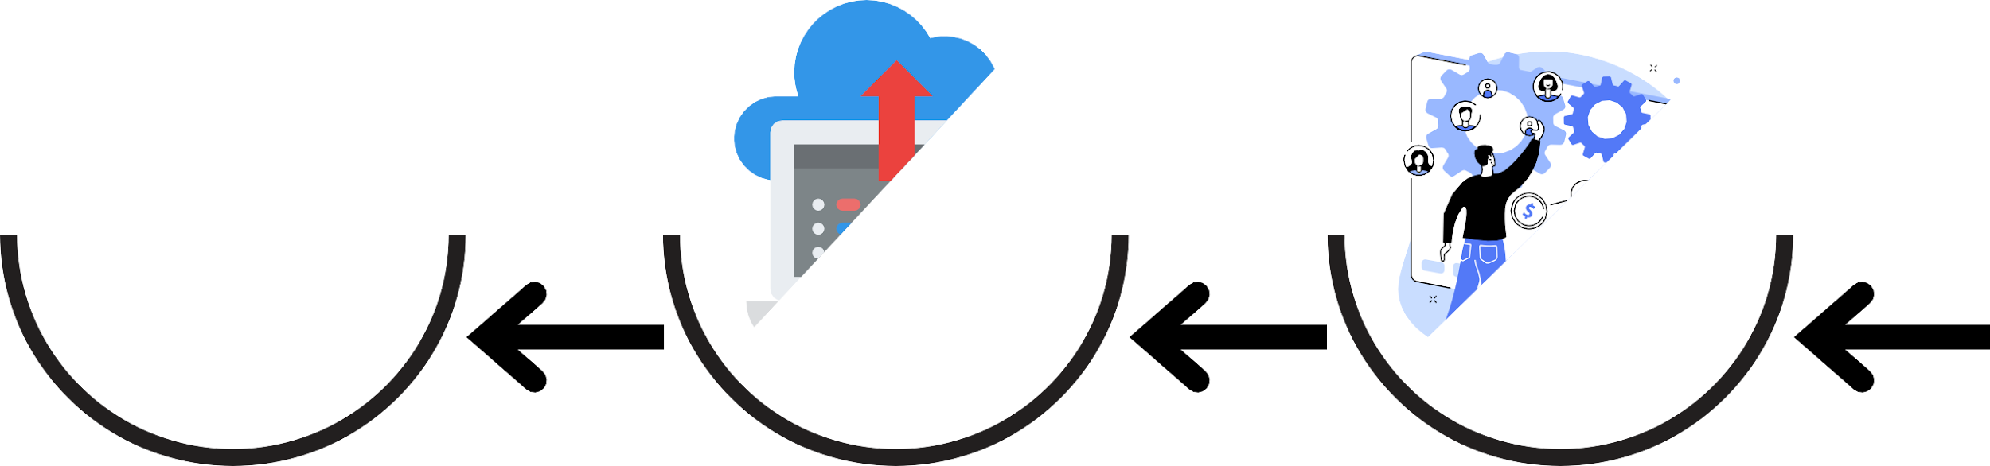








Overview
Data Sources
Schema
Data Warehouse
AZURE Data Studio
Automated ML
Deployment
Prediction Model
EDA

Slide 6
Week 1

Slide 7
1. Database Design
Focus: Designing a robust SQL database schema to effectively manage customer data. This schema will handle everything from customer details to interactions, providing a solid foundation for future data analysis and reporting.
Key Message: A well-designed database is the cornerstone of effective customer data management, ensuring data consistency, integrity, and scalability.

Slide 8
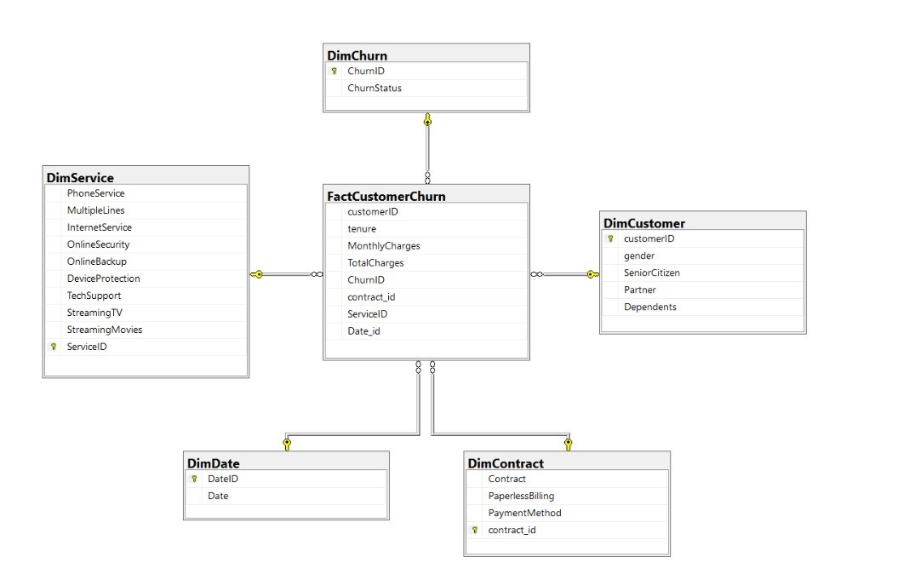
2. SQL Database Implementation
Focus: Using Microsoft SQL Server to create and populate a fully functioning database. This includes setting up the necessary tables and relationships for handling complex customer datasets.
Key Message: Leverage SQL Server's powerful capabilities to manage large volumes of customer data efficiently, ensuring that all information is organized and accessible for future analysis.

Slide 9
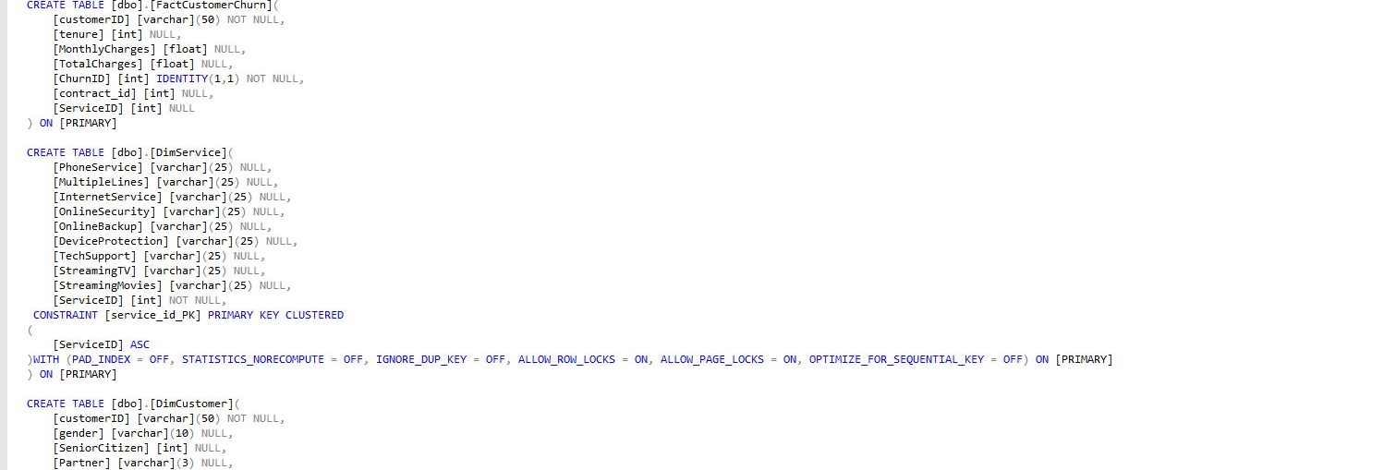
2. SQL Database Implementation

Slide 10

3. SQL Queries for Data Extraction and Analysis
Focus: Writing optimized SQL queries to extract, update, and analyze customer data. These queries will allow for detailed reporting on customer behavior, transaction history, and interaction patterns.
Key Message: By developing well-structured queries, the project
will enable quick insights into customer data, business decisions and enhancing customer management (CRM).
supporting relationship

Slide 11
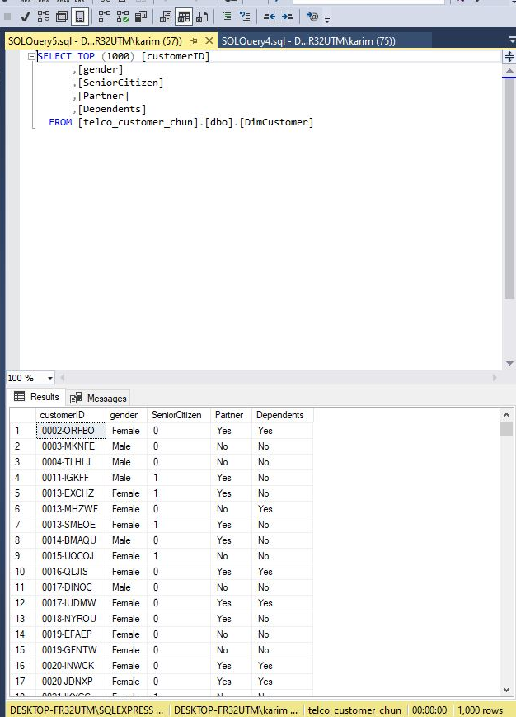
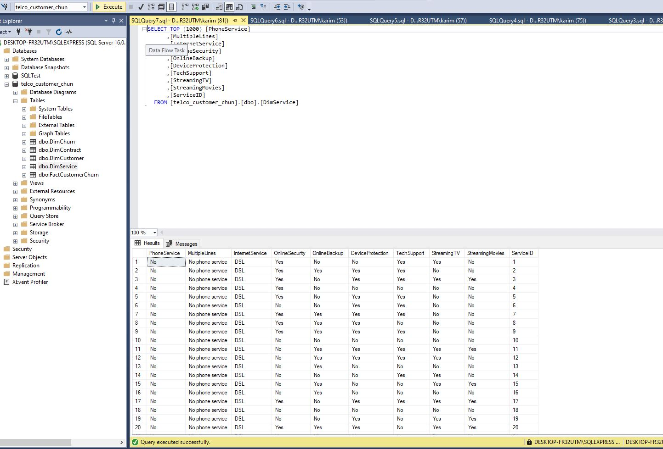
3. SQL Queries for Data Extraction and Analysis

Slide 12
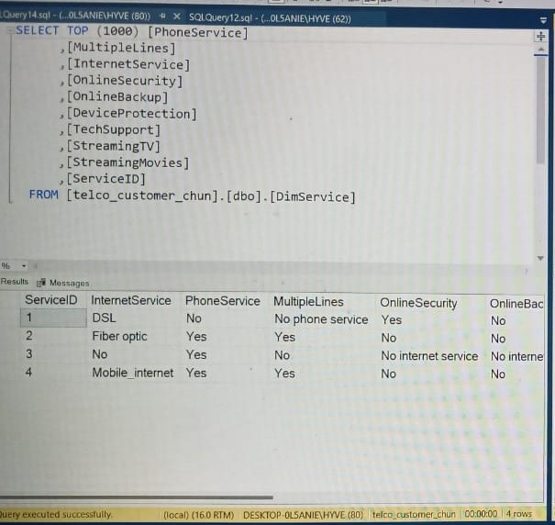
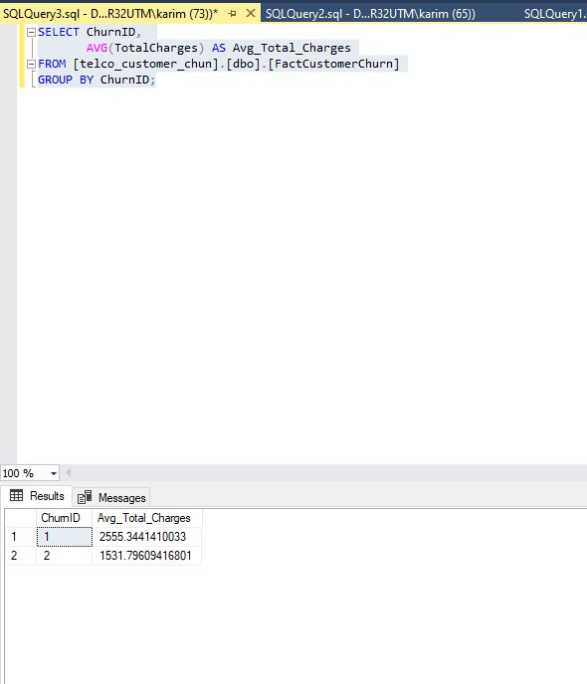
3. SQL Queries for Data Extraction and Analysis
Phone Services
Average Total Charges by Churn

Slide 13
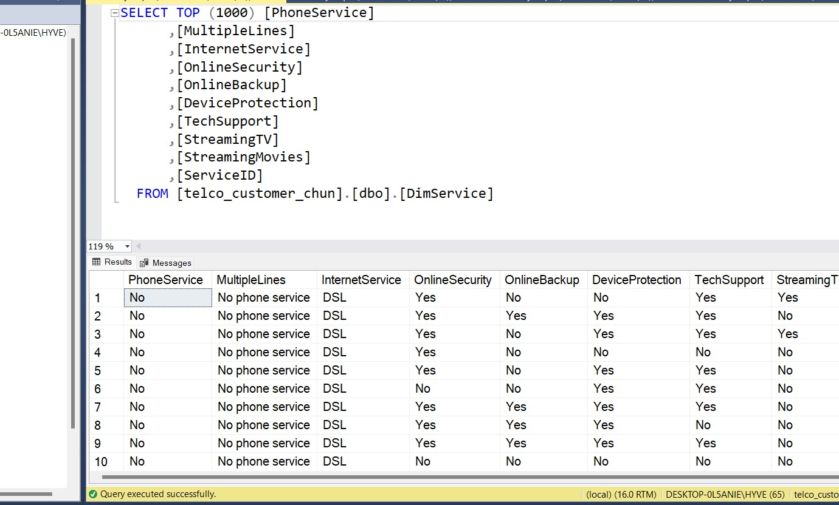
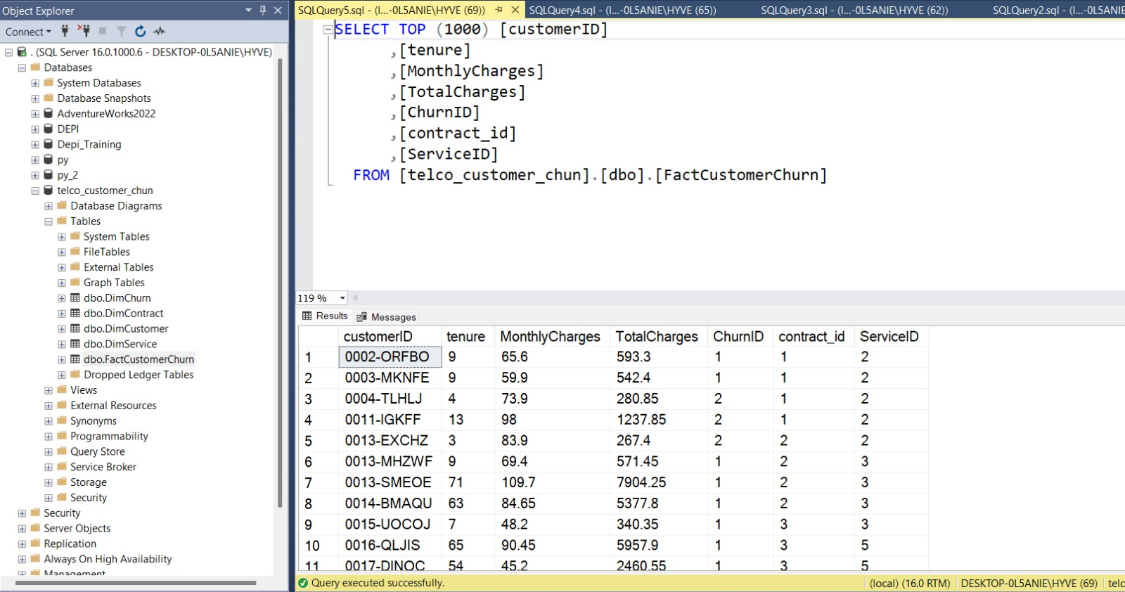
3. SQL Queries for Data Extraction and Analysis

Slide 14
Week 2

Slide 15
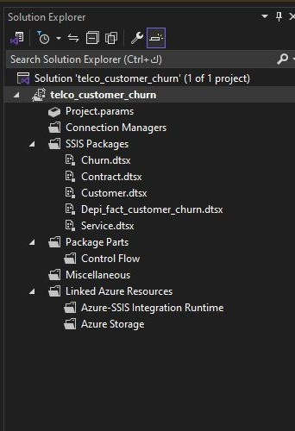
2. SQL Data Warehouse Implementation
Focus: Setting up a SQL Data Warehouse to centralize customer data from multiple sources for efficient storage and analysis. This warehouse will enable high- performance queries and provide a foundation for reporting and advanced analytics.
Key Message: The SQL Data Warehouse
offers an optimized, centralized platform for managing large-scale customer data, ensuring faster data retrieval and improved analytics performance.

Slide 16
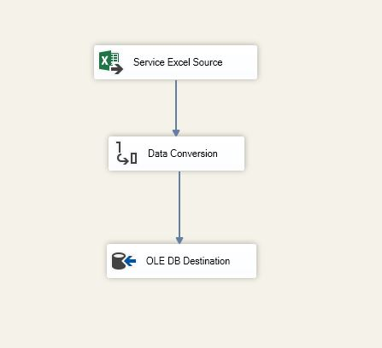
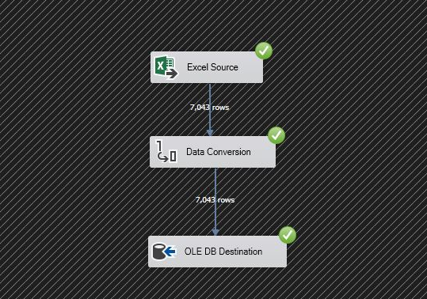
3. Data Integration
Focus: Extracting, transforming, and loading (ETL) data from various sources into the data warehouse, including customer interactions, transactions, and demographic data.
Key Message: Seamless data integration from diverse sources into a unified data warehouse allows for comprehensive customer data management, making all relevant data readily available for insights.

Slide 17
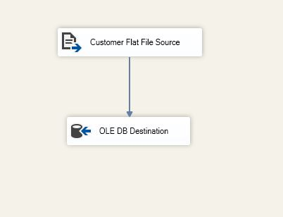
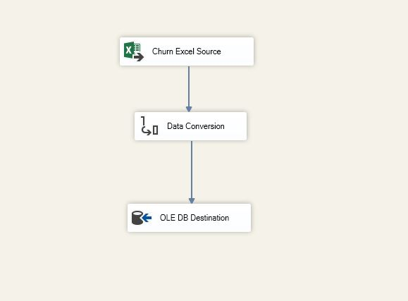
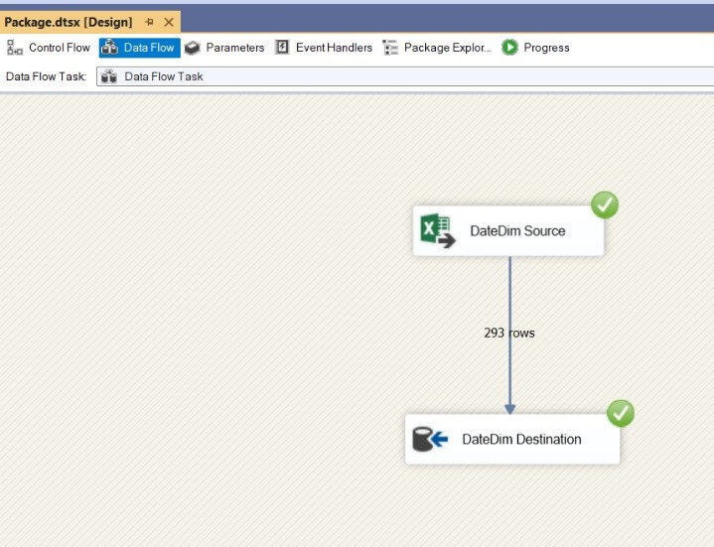
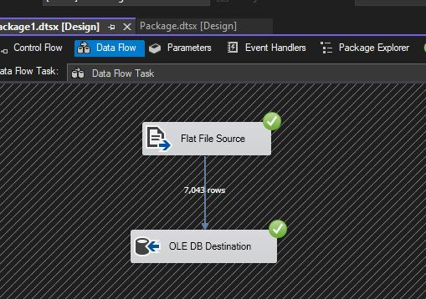
3. Data Integration

Slide 18
Week 3

Slide 19
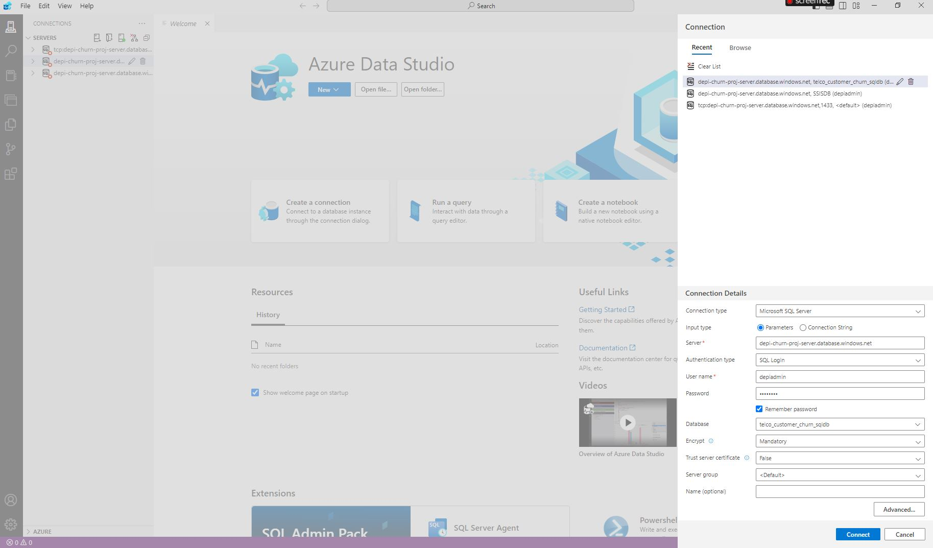
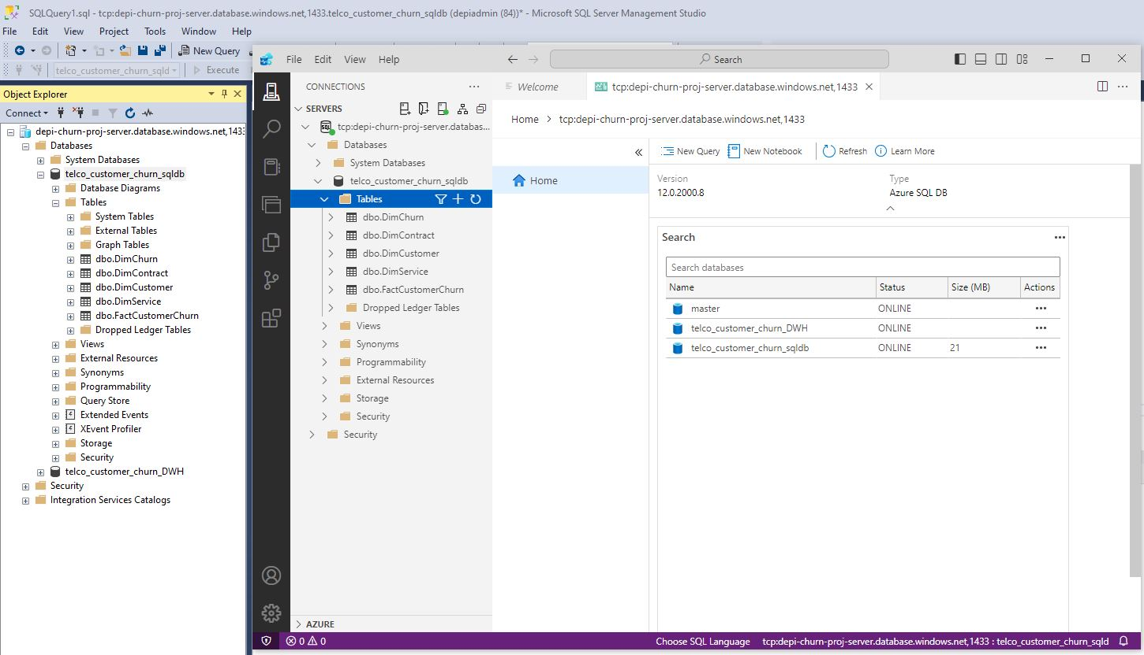
Data AZURE
"We have deployed both our database and data warehouse on Azure so that we can access them from anywhere, and they are available to everyone on the cloud using Azure data studio. This setup ensures that the data is centralized, scalable, and easily accessible for all team members."

Slide 20
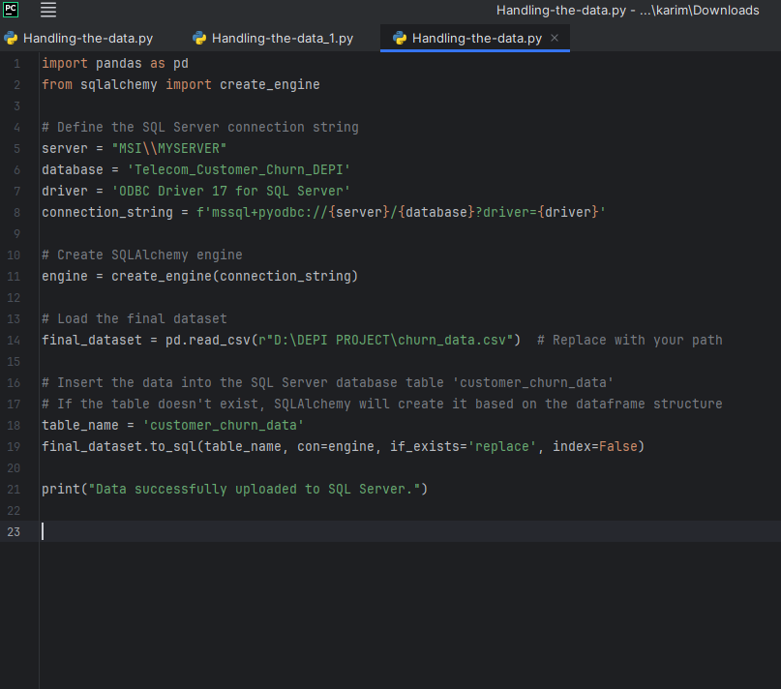
Data Ingestion Process from SQL Server

Slide 21
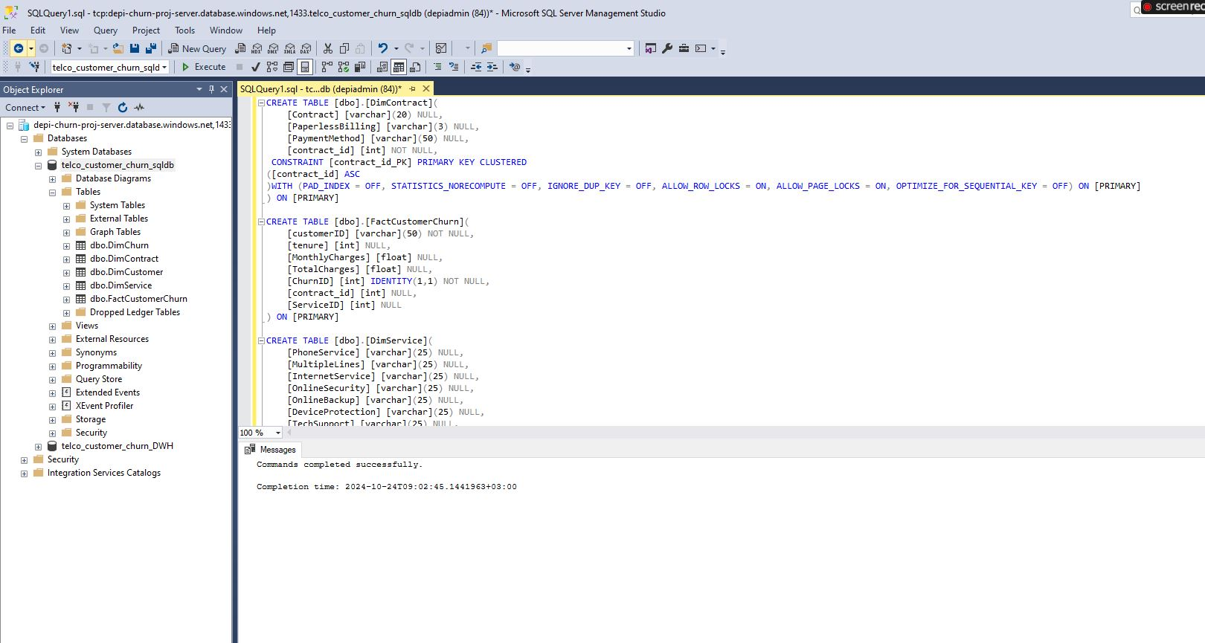
Exploratory Data Analysis (EDA)

Slide 22
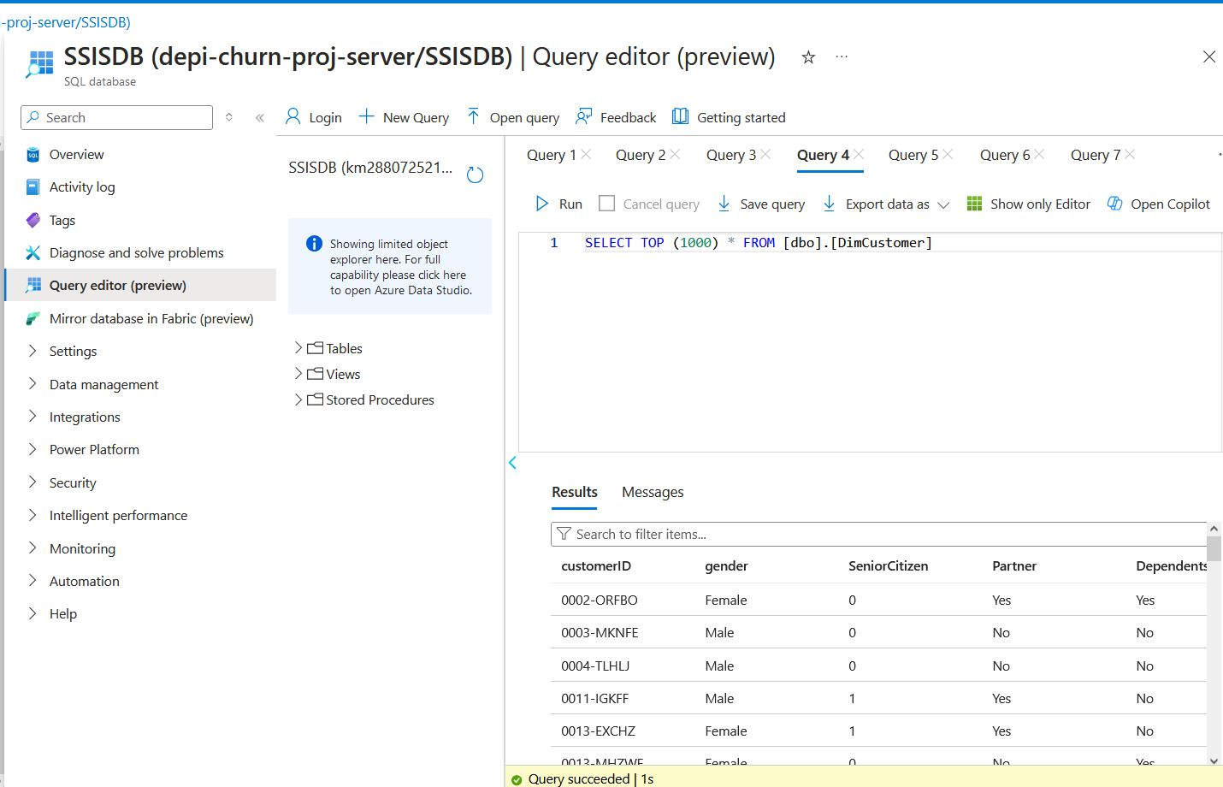

Slide 23
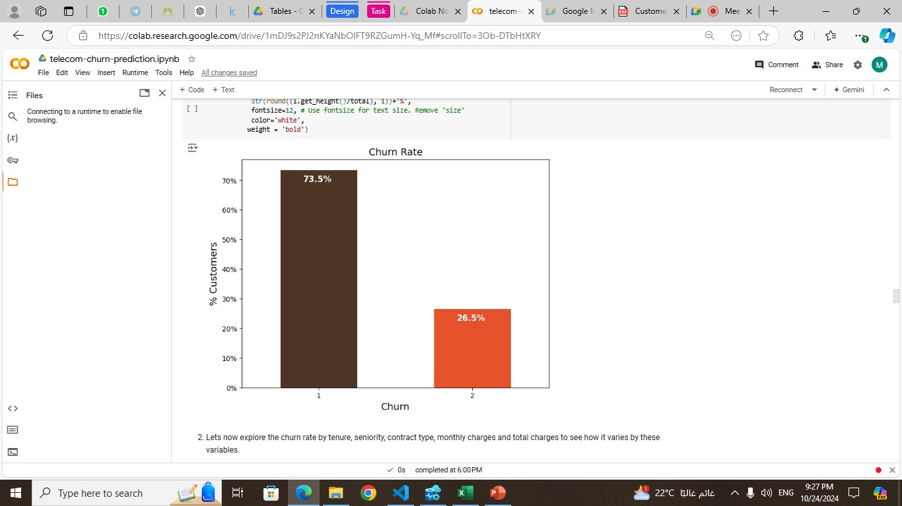
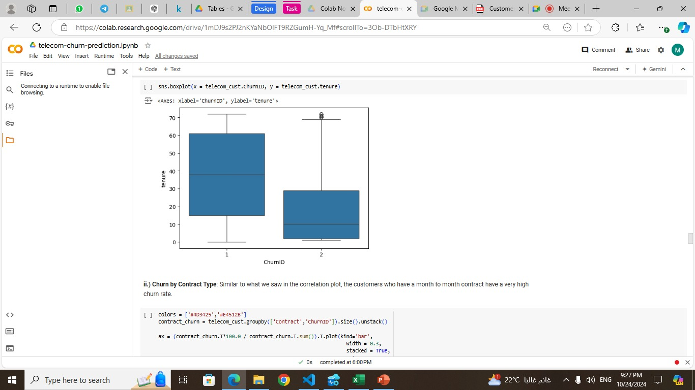
Exploratory Data Analysis (EDA)

Slide 24
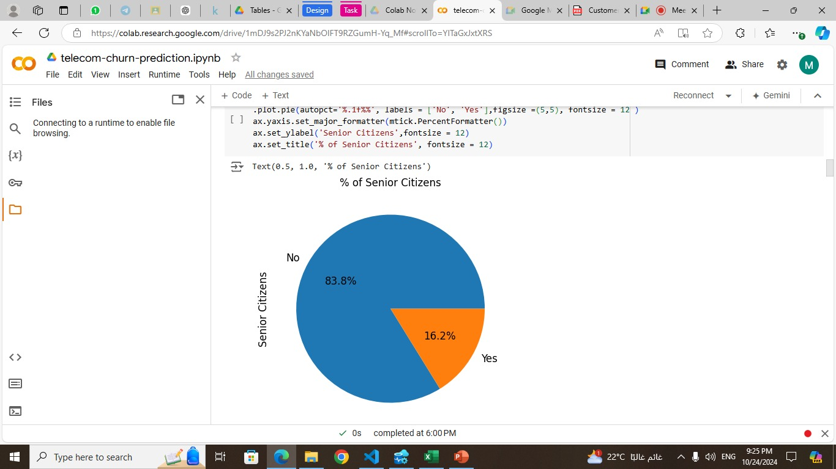
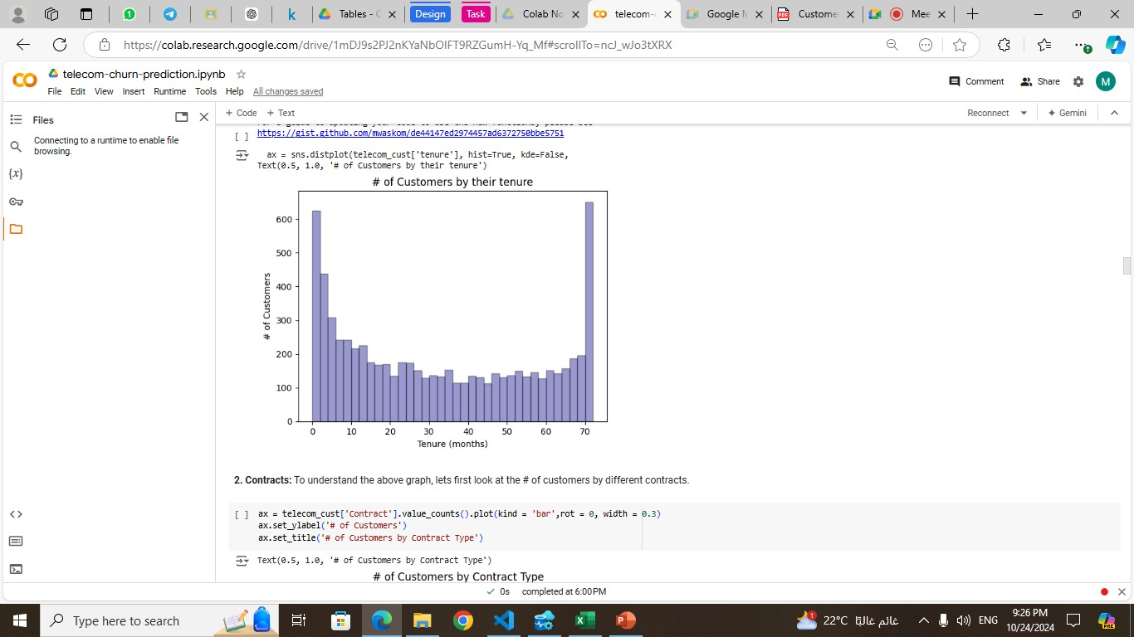
Exploratory Data Analysis (EDA)

Slide 25
Week 4

Slide 26
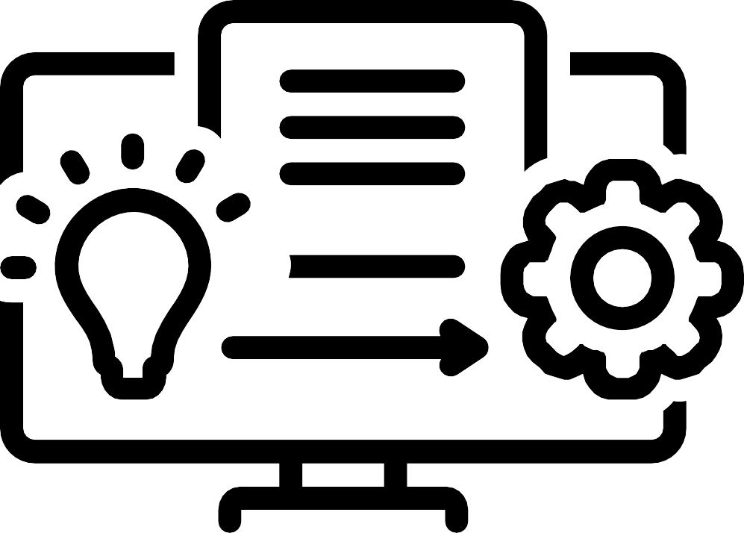
1. MLOps Implementation with Streamlit
Focus: Implement MLOps using Streamlit to create a user-friendly web interface that allows users to interact with machine learning models in real-time. Streamlit makes it easy to track model predictions and provide an interface for non-technical stakeholders.
Key Message: Streamlit simplifies the MLOps process by allowing rapid development of interactive web applications, providing easy access to model outputs, and facilitating real- time predictions without complex infrastructure.

Slide 27
2. Model Deployment
Focus: Deploy the machine learning model for scalability or through Streamlit, allowing for direct user interaction with the predictive model via a web app.
Key Message: With Streamlit, deployment is quick and simple, making it possible for businesses to utilize real-time machine learning insights through a customizable, accessible web interface.

Slide 28
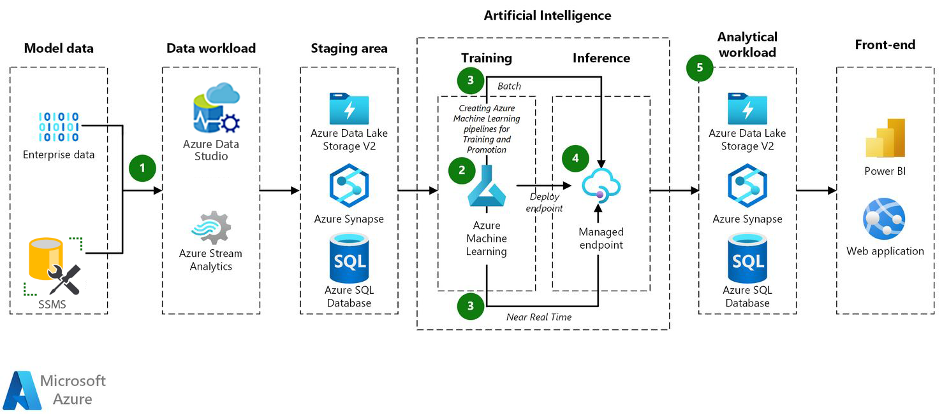
End to End Model Life Cycle

Slide 29
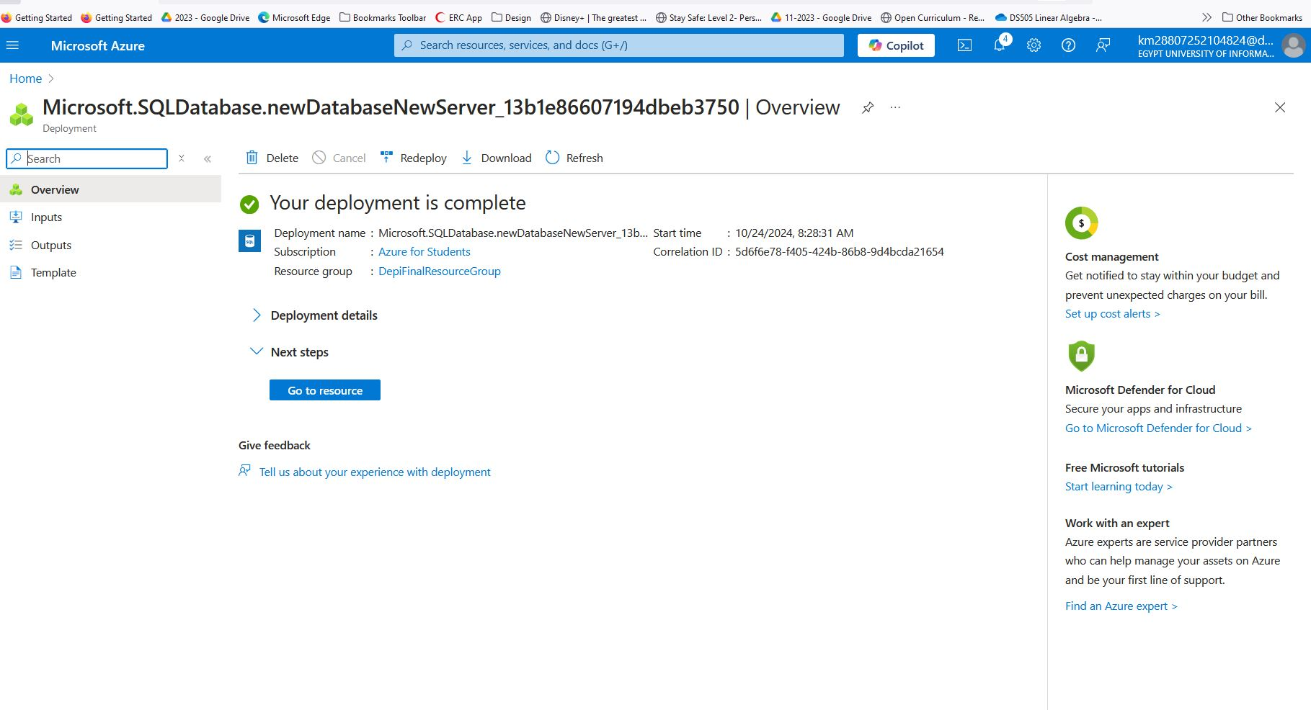
Azure SQL Database Deployment

Slide 30
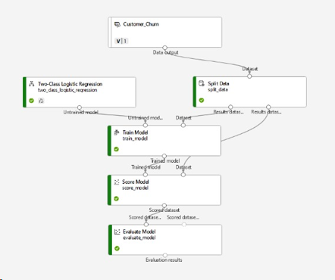
Model Pipeline Deployment & Evaluation

Slide 31
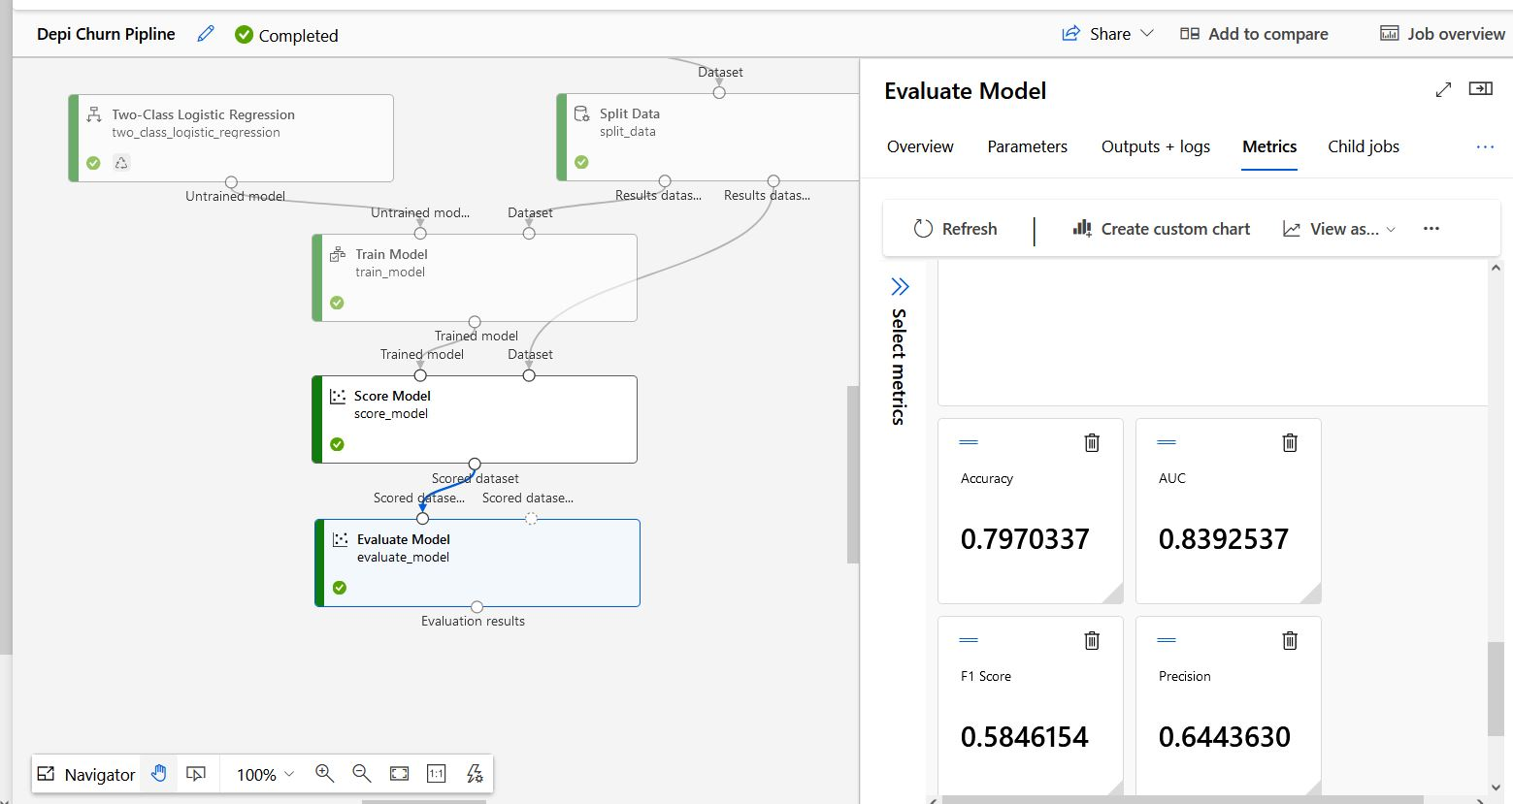
Model Pipeline Evaluation Acuracy

Slide 32
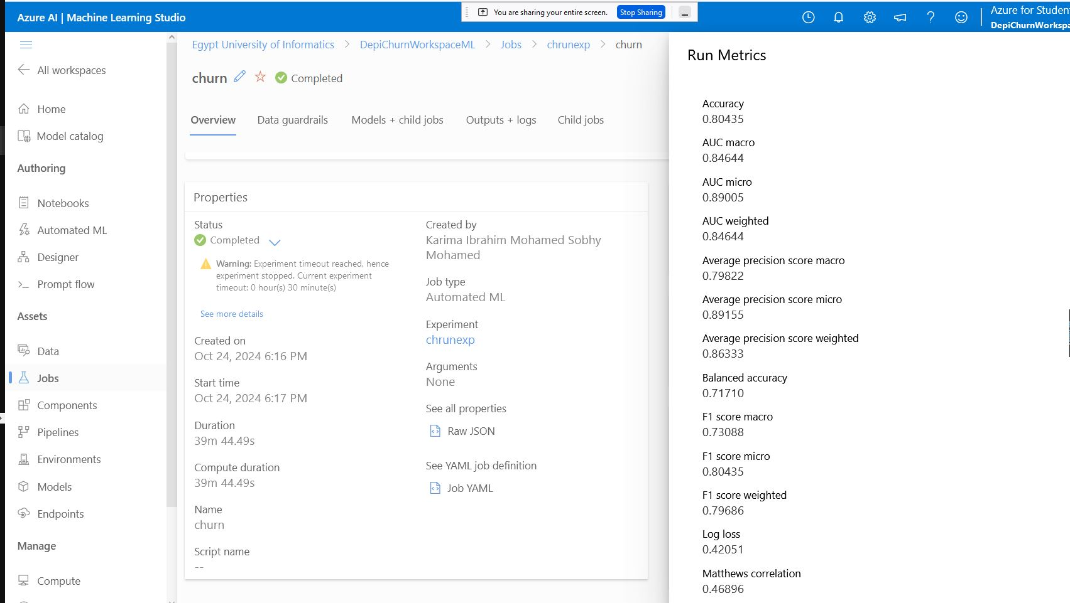
Automated ML Models

Slide 33
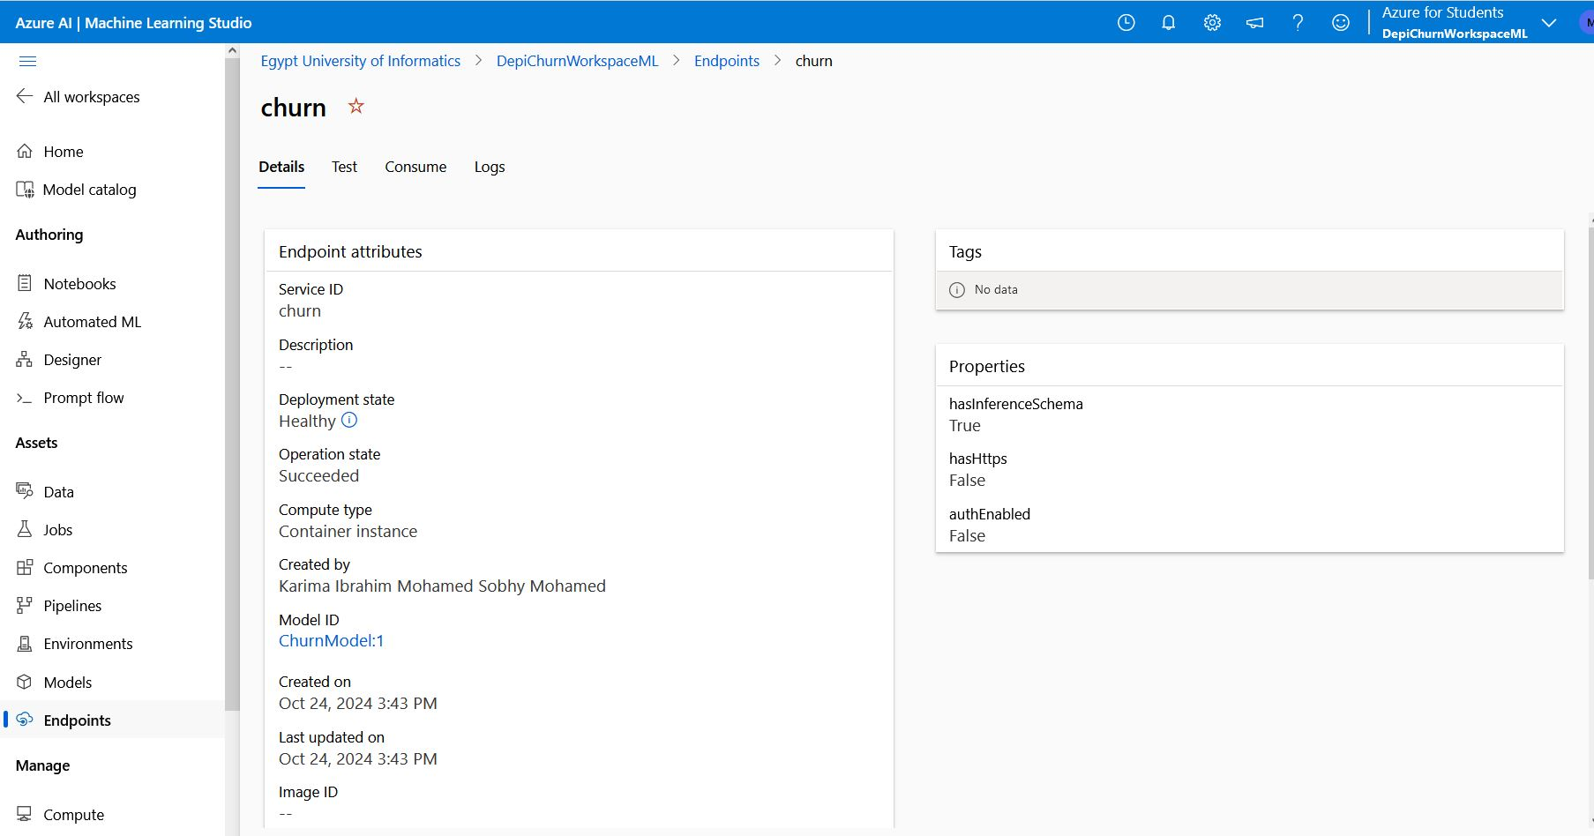
Model End Points

Slide 34
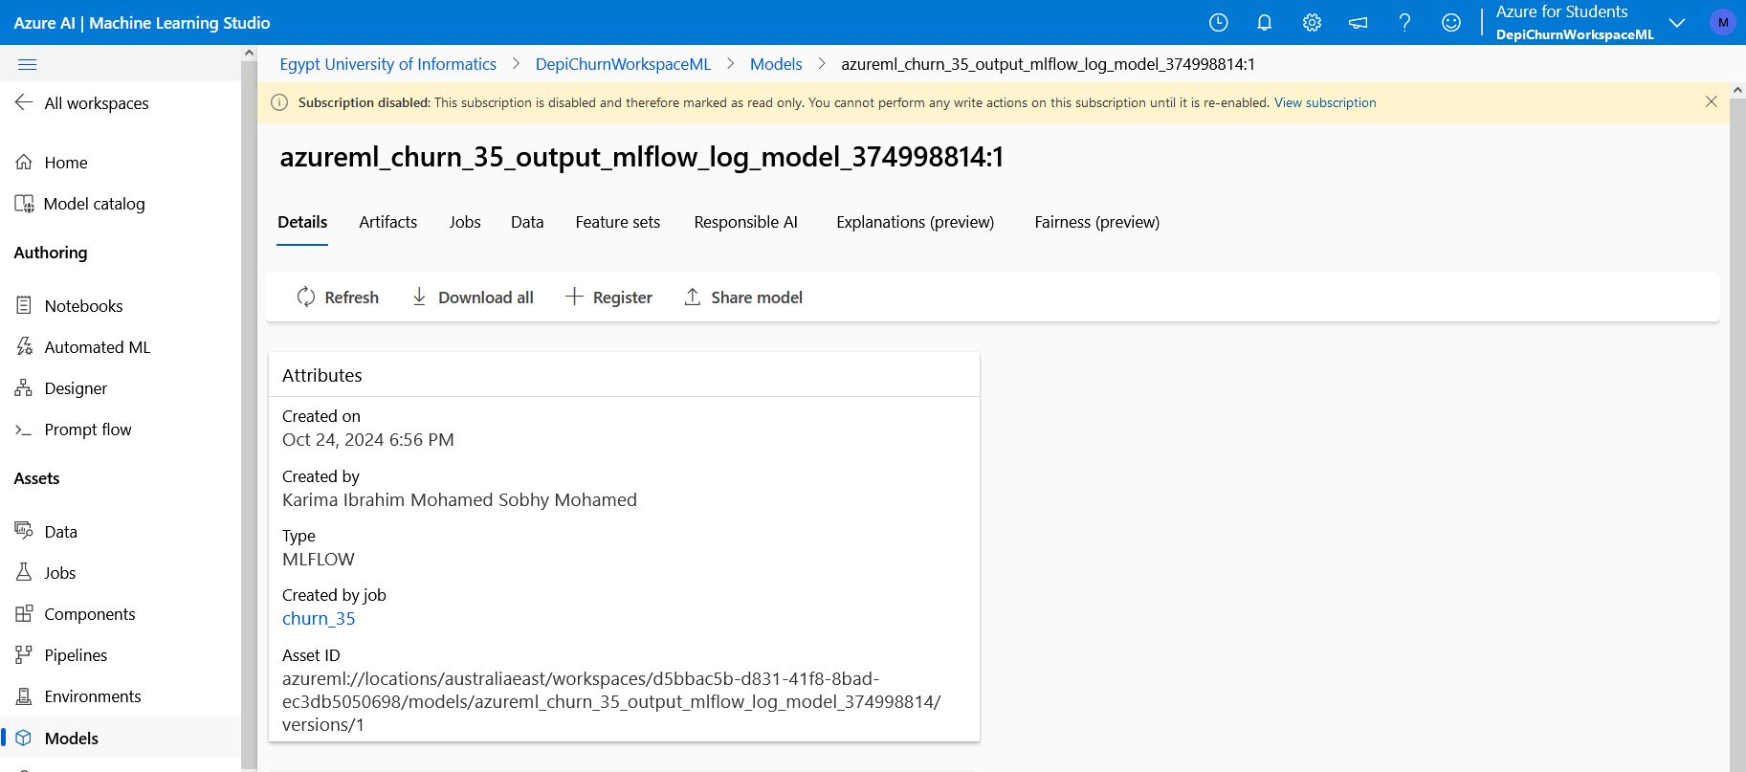
Track Customer Churn experiments using MLflow

Slide 35
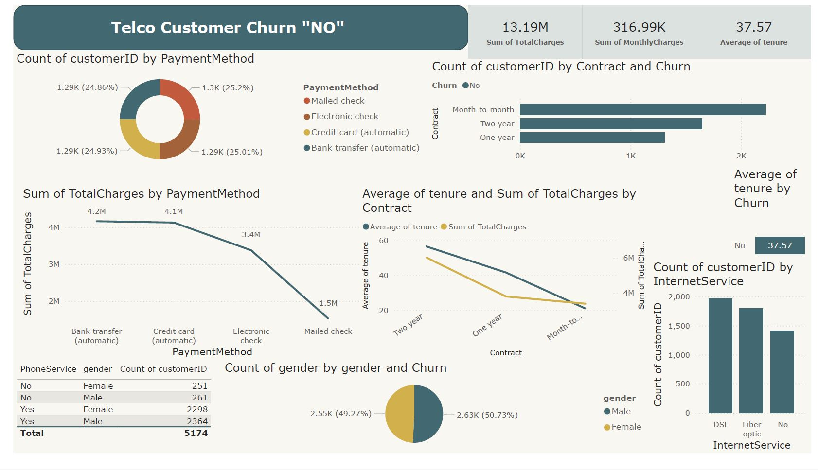
Final Report using Power BI Dashboard

Slide 36

PRESENTATI ON - 2024
................
THANK YOU
................

